Slide 1

MODEL
DEPLOYMENT
DONE BY HASSAN,NAGUIB AND REDA

Slide 2
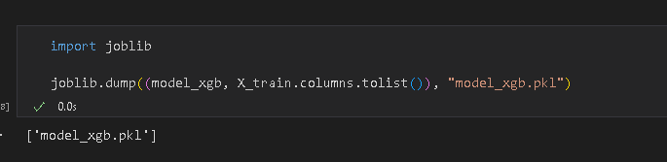
Model Extraction
We extracted the xgboost model since it had the highest accuracy using the Joblib.

Slide 3
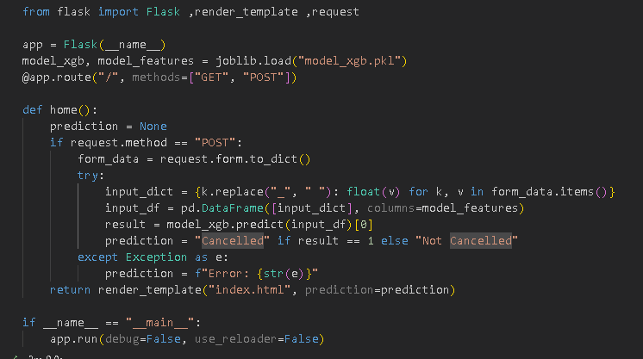
Flask
using flask library we created a web application by loading the model with the highest accuracy (after filtering and removal of outliers and impurities) which was XGboost

Slide 4
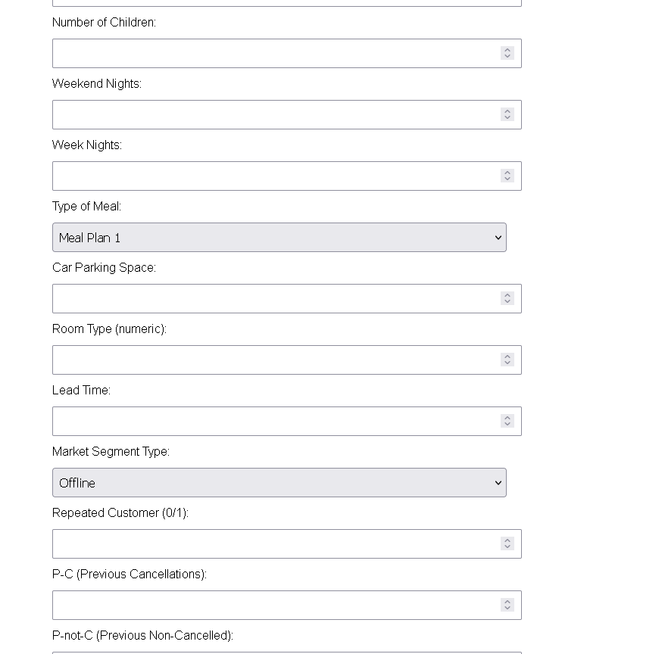
HTML
We added in the body (HTML) usable input buttons for our features in order to check if the customer will cancel or not,
there were choice buttons and input buttons
and the output came using the prediction

Slide 5
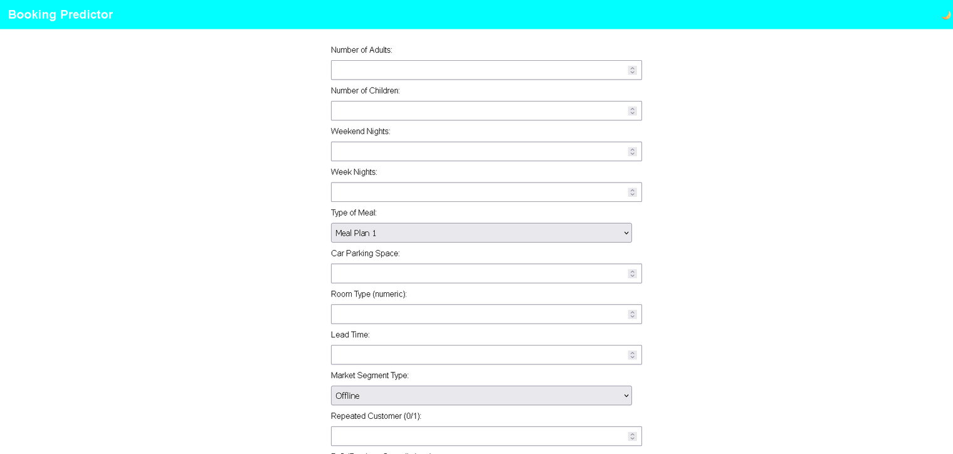
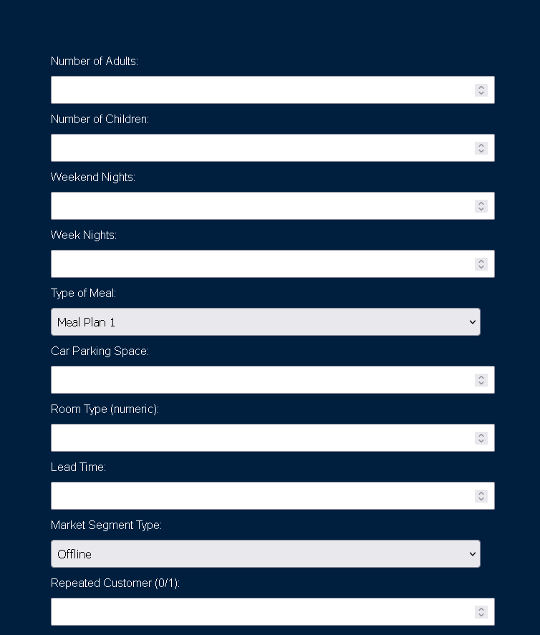
CSS
Created a style for all of the pages and added functionality for the dark mode button where it changes the page from white to dark blue and Made the buttons feel modern.

Slide 6
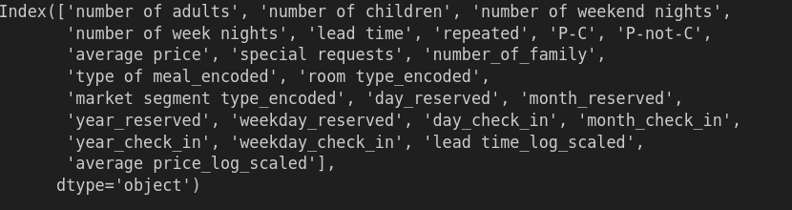
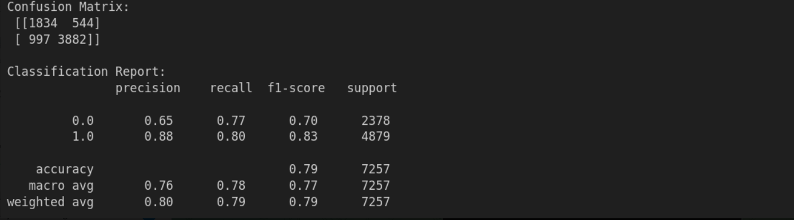
Modeling
Features
LOGISTIC REGRESSION

Slide 7
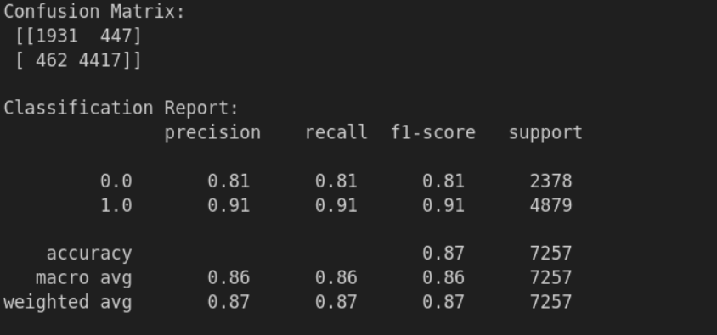
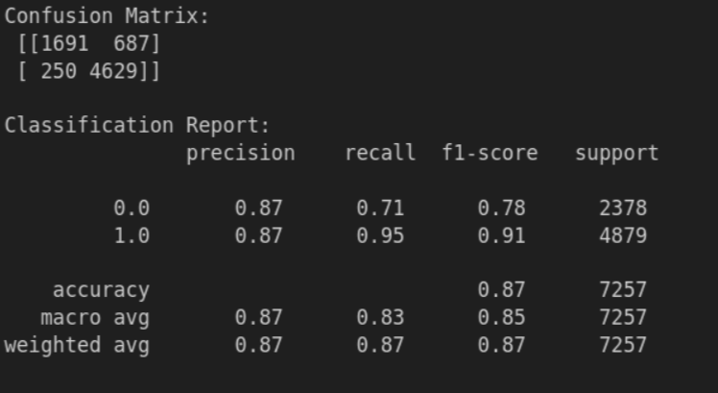
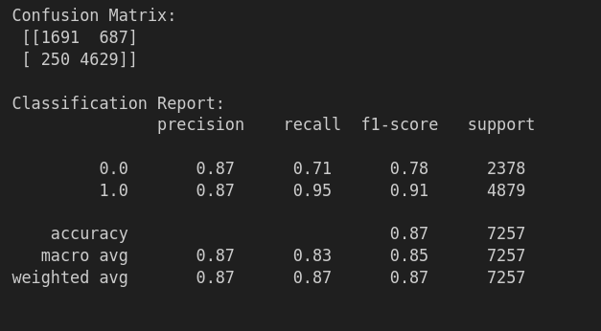
XGBOOST
RANDOM FORREST
SVM

Slide 8

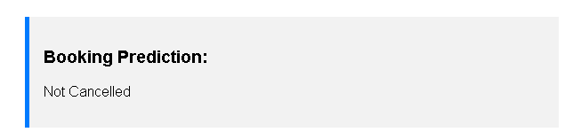
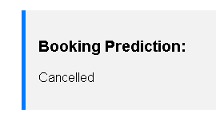
In conclusion
The model is highly trained with 0.88 accuracy and the application is able to preform as predicted

Slide 9
Thank you very much!

